Slide 1
Java

Slide 2
Type casting
The process of converting the value of one data type to another
Widening/implicit type casting
Narrowing/Explicit type casting

Slide 3
Widening type casting
In Widening Type Casting, Java automatically converts one data type to another data type.
In the case of Widening Type Casting, the lower data type (having smaller size) is converted into the higher data type (having larger size). Hence there is no loss in data. This is why this type of conversion happens automatically.

Slide 4
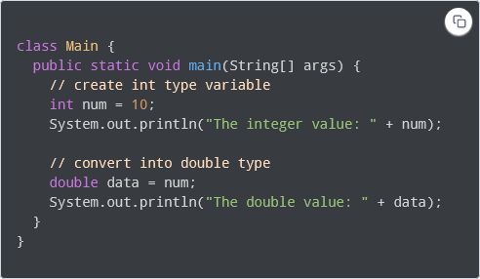
Widening type casting

Slide 5
Narrowing type casting
In Narrowing Type Casting, we manually convert one data type into another using the parenthesis.
In the case of Narrowing Type Casting, the higher data types (having larger size) are converted into lower data types (having smaller size). Hence there is the loss of data.

Slide 6
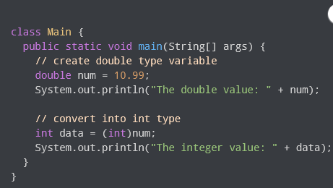
Narrowing type casting

Slide 7
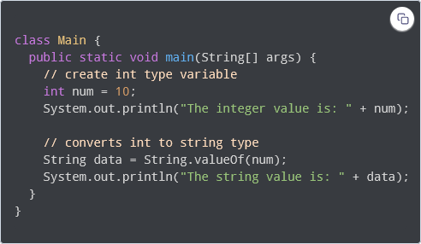
Type conversion from int to String

Slide 8
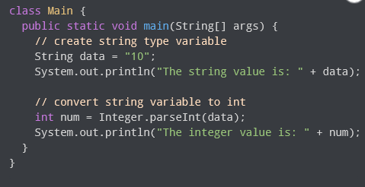
Type conversion from String to int

Slide 9
Control flow statements
Decision Making statements
if statements
switch statement
Loop statements
do while loop
while loop
for loop
for-each loop
Jump statements
break statement
continue statement

Slide 10
Decision making statements
Decision-making statements decide which statement to execute and when.
Decision-making statements evaluate the Boolean expression and control the program flow depending upon the result of the condition provided.
There are two types of decision-making statements in Java, i.e., If statement and switch statement

Slide 11
If statement
The condition of the If statement gives a Boolean value, either true or false. In Java, there are four types of if-statements given below.
Simple if statement
if-else statement
if-else-if ladder
Nested if-statement

Slide 12
Simple IF statement
It evaluates a Boolean expression and enables the program to enter a block of code if the expression evaluates to true.
Syntax of if statement is given below.
if(condition) {
statement 1; //executes when condition is true }

Slide 13
If-else statement
The if-else statement is an extension to the if-statement, which uses another block of code, i.e., else block. The else block is executed if the condition of the if-block is evaluated as false.
Syntax:
if(condition) {
statement 1; //executes when condition is true
}
else{
statement 2; //executes when condition is false
}

Slide 14
If-else-if ladder
if(condition 1) {
statement 1; //executes when condition 1 is true
}
else if(condition 2) {
statement 2; //executes when condition 2 is true
}
else {
statement 2; //executes when all the conditions are false
}

Slide 15
Nested if
In nested if-statements, the if statement can contain a if or if-else statement inside another if or else-if statement.
if(condition 1) {
statement 1; //executes when condition 1 is true
if(condition 2) {
statement 2; //executes when condition 2 is true
}
else{
statement 2; //executes when condition 2 is false
}
}

Slide 16
Switch Statement
Similar to if-else-if statements. The switch statement contains multiple blocks of code called cases and a single case is executed based on the variable which is being switched.
Points to be noted about switch statement:
The case variables can be int, short, byte, char, string, or enumeration.
Cases cannot be duplicate
Default statement is executed when any of the case doesn't match the value of expression. It is optional.
Break statement terminates the switch block when the condition is satisfied. It is optional, if not used, next case is executed.

Slide 17
Loop statements
Sometimes we need to execute the block of code repeatedly while some condition evaluates to true. However, loop statements are used to execute the set of instructions in a repeated order. The execution of the set of instructions depends upon a particular condition.
for loop
while loop
do-while loop

Slide 18
For loop
We use the for loop only when we exactly know the number of times, we want to execute the block of code.
Syntax
for(initialization, condition, increment/decrement) {
//block of statements
}

Slide 19
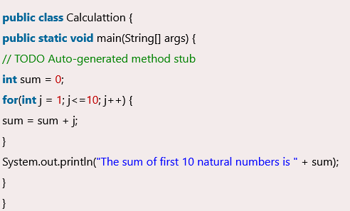
For loop example

Slide 20
While loop
If we don't know the number of iterations in advance, it is recommended to use a while loop.
It is also known as the entry-controlled loop since the condition is checked at the start of the loop. If the condition is true, then the loop body will be executed; otherwise, the statements after the loop will be executed.
while(condition){
//looping statements
}

Slide 21
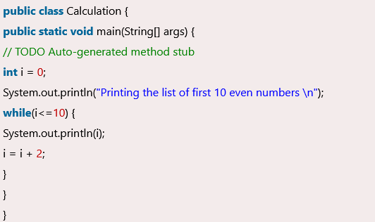
While loop

Slide 22
Do while loop
Checks the condition at the end of the loop after executing the loop statements. We have to execute the loop at least once
It is also known as the exit-controlled loop since the condition is not checked in advance.
do{
//statements
} while (condition);

Slide 23
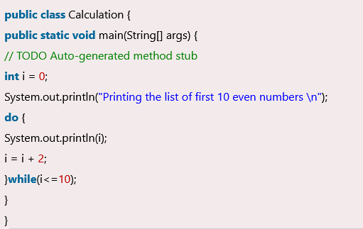
DO while

Slide 24
Jump Statement
Used to transfer the control of the program to the specific statements. In other words, jump statements transfer the execution control to the other part of the program.
There are two types of jump statements in Java, i.e., break and continue.

Slide 25
Break statement
Used to break/stop the current flow of the program and transfer the control to the next statement outside a loop or switch statement. However, it breaks only the inner loop in the case of the nested loop.
The break statement cannot be used independently in the Java program, i.e., it can only be written inside the loop or switch statement.

Slide 26
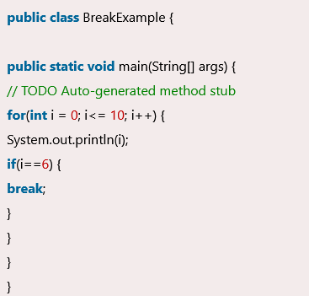
Break example

Slide 27
Continue statement
Unlike break statement, the continue statement doesn't break the loop, whereas, it skips the specific part of the loop and jumps to the next iteration of the loop immediately.

Slide 28
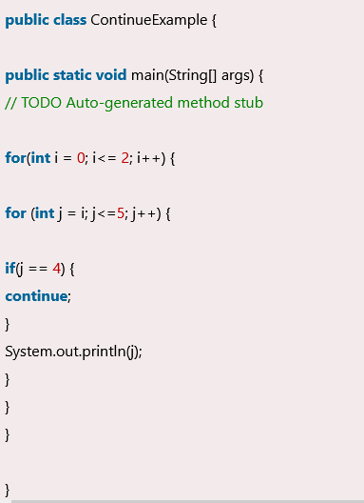
Continue

